Slide 1
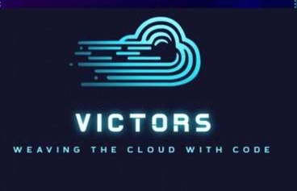






WEB-IT-UP!
NAME- Satvik Jayalwal
ROLL.NO- 25902
BRANCH- Cse
THEME- Travel and Tourism

Slide 2
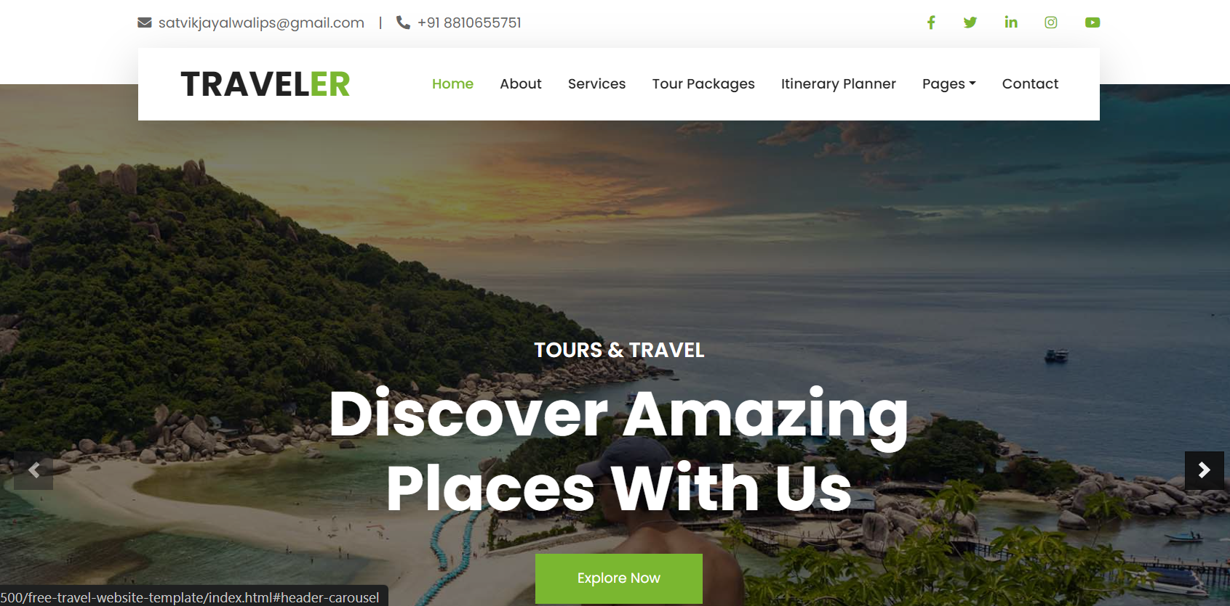
01. IDEA TITLE
Detailed Explanation of the Proposed Solution:
Comprehensive travel website designed to help users easily plan, book, and manage their trips in one place.
Search and compare flights, book hotels, and organize their itinerary on the website.
Manage travel budgets and track their expenses throughout the trip.
Customized travel recommendations based on user preferences, previous bookings, and seasonal deals.
How It Addresses the Problem:
Time-saving
Stress reduction
Affordable travel options
Innovation and Uniqueness of the Solution:
The website uses automation to compare and provide real-time travel deals from different platforms, saving users time and money.
Dynamic budget tracker automatically adjusts based on the user's bookings and expenses, offering real-time expense tracking.
Interactive maps and travel planners, allowing users to visualize their trip from start to finish.
Personalized travel suggestions
Seamless user experience across devices: the website is optimized for both desktop and mobile, allowing for planning on the go.

Slide 3
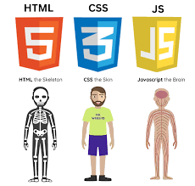

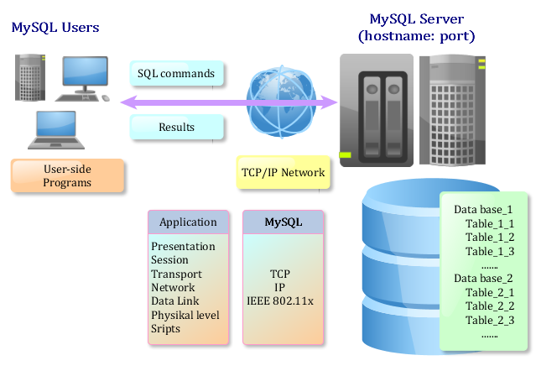

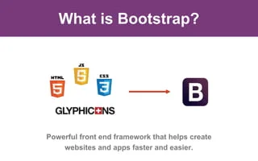

02. TECHNICAL APPROACH
Technologies to Be Used:
Programming Languages: HTML, CSS, JavaScript (frontend); Python (backend);
Frameworks: Flask/Django (backend), Bootstrap (responsive design).
Database: MySQL (secure data storage).
Automation: Selenium WebDriver (real-time deal comparisons).
Version Control: Git (code management).
AI recommendation systems

Slide 4
03. FEASIBILITY AND VIABILITY
Technological Feasibility:
Uses widely-adopted, proven technologies (HTML, CSS, Python, MySQL).
Automation tools (Selenium) streamline processes, making it easier to implement.
Time Feasibility:
Development timeline is manageable with an agile methodology for faster iterations.
Modular approach allows incremental feature release, improving development speed.
Financial Feasibility:
Low-cost development using open-source tools and frameworks.
Cloud services (AWS, Google Cloud) offer cost-effective scalability based on demand.
Potential for revenue generation through affiliate marketing, travel bookings, and ads.
Resource Feasibility:
Requires a small development team proficient in web development, automation, and data security.
Cloud-based infrastructure reduces the need for heavy hardware investments.
Scalability:
Cloud infrastructure ensures the platform can grow with the user base.
Able to handle real-time data updates, high traffic during peak travel seasons.
User Demand:
High demand for automated, easy-to-use travel planners and budget management tools.
Appeals to diverse user segments like budget travelers, families, and solo adventurers.
Challenges & Risks | Strategies to Overcome
Data Accuracy | Use automated validation and frequent API updates.
System Integration | Implement API gateways for smooth multi-service integration.
User Trust & Security | Apply SSL encryption and MFA for data protection.
Scalability | Use cloud infrastructure with auto-scaling for traffic management.
User Experience | Ensure responsive design for seamless use on all devices.
Competition | Offer unique features like budget tracking and personalized suggestions.
Development Resources | Use agile development to stay flexible and on track.
User Adoption | Launch targeted marketing and initial promotions to attract users.

Slide 5
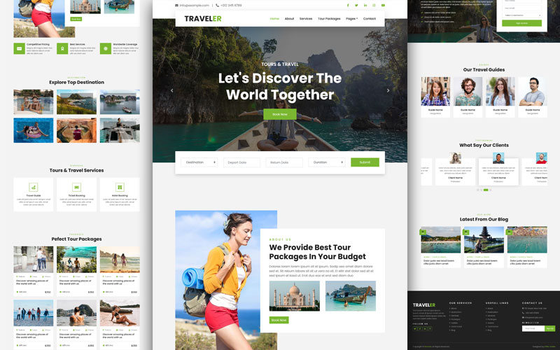
04. IMPACT AND BENEFITS
Explore:
Discover top travel destinations with ease.
Access real-time information on local attractions and dining.
Budgeting:
Track your travel expenses effortlessly.
Set and adjust your budget in real-time to stay on track.
Itinerary Planning:
Organize your trip day-by-day.
Ensure you visit all must-see places with a structured itinerary.
AI Assistant:
Get personalized travel tips and recommendations.
Seamless trip planning with AI-guided suggestions.

Slide 6
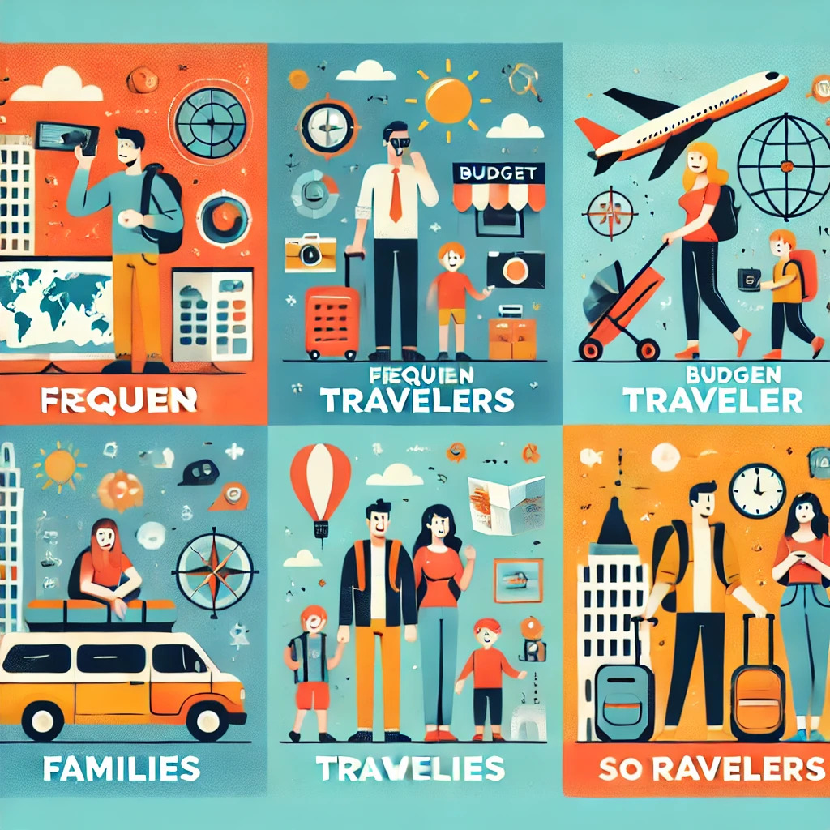
05. Market Strategies
Identify Your Target and Their Needs:
Frequent Travelers: Seek efficient planning tools and budget management.
Budget Travelers: Prioritize affordable deals and real-time comparisons.
Families: Need comprehensive travel options that cater to all ages.
Solo Travelers: Value personalized recommendations and safety.
Marketing Plan:
User Acquisition:
Leverage travel blogs, influencers, and social media ads.
Collaborate with travel agencies and booking platforms for promotions.
User Engagement:
Push notifications with personalized travel deals and updates.
In-app rewards for loyal users and frequent bookings.
Scaling the Solution:
Phase 1: Start with local partnerships and targeted advertising campaigns.
Phase 2: Expand globally with multilingual support and regional deals.
Phase 3: Introduce subscription-based premium services and exclusive travel deals.
LINK FOR REFERENCE :
https://wanderlog.com/

